Slide 1
Pollution
Pollution: undesirable change in chemical, physical and biological characteristics of air, water , soil & sound which causes the health problems to all the living and non living beings
Types:
Air, Soil, Water, Noise, E-waste
Categories:
Indoor, Outdoor

Slide 2
Noise Pollution
The unpleasant, high intensity sound is called as noise
Sound of unpleasant and annoying nature
Unit of measurement of sound is decibel (dB)
Range: 1dB to 140 dB
< 1 dB – can not hear , >140 dB- Can not stand
Normal talk- 40 dB, shouting 60 dB

Slide 3
Sources of Noise Pollution
Industrial Activities
Transport
Domestic/ Home
Cultural Activities
Agricultural activities
Defense activities
Mining activities: blasting
Construction, earthquake etc.

Slide 4
Effects of Noise Pollution
Physical Effects:
Temporary hearing problem
permanent deafness
damage to tympanic membrane
Physiological effects:
Headache
Heart pain
reduction in vision
Rise in blood pressure
Memory less
Psychological effects:
Depression, Fatigue, Frustration, Irritation

Slide 5
Prevention of Noise Pollution
Planting bushes and trees in and around sound generating sources
Regular servicing and tuning of automobiles
Buildings can be designed with suitable noise absorbing material for the walls, windows, and ceilings
Workers should be provided with equipment's such as ear plugs and earmuffs
Soundproof doors and windows
Regulations should be imposed to restrict
Factories and industries should be located far from the residential areas
Community development or urban management
Social awareness programs

Slide 6
Water Pollution
chemical, physical and biological change in which causes the health problems to all the living and non living beings
pH value of drinking water should be in between 7 & 8.5
Sources of water pollution:
point- source is identifiable
non point- source is not identifiable

Slide 7
Waste Water
Water become unsafe for drinking due to accumulation of sewage & other waste in nearby stream, lake or pound
Detergents contains phosphates which grows algae. It consumes dissolved oxygen in water and decompose plant. It produce toxin in water which will harmful to animals
Foul smell

Slide 8
Sources of water pollution
Industrial discharges, solid waste
Agricultural discharges- phosphates & nitrates increase nutrient of water for more production: Eutrophication.
Decrease oxygen value and increase co2 level which
affects aqua plants
Domestic use

Slide 9
Effects of water pollution
Kill aqua life
Health problems
Decrease oxygen level
Diseases: diarrheal diseases, including Cholera, and other serious illnesses such as Guinea worm disease, Typhoid, and Dysentery.
Minamata disease caused by mercury poisoning observed in japan, 1956

Slide 10
Prevention of water pollution
Disinfection of water: killing of bacteria using chlorine
Sedimentation: remove suspended material, tanks are used
Filtration:
Softening: removal of hardness through boil and adding lime

Slide 11
Soil Pollution
Soil is a thin layer of mixtures of minerals, organic matter, inorganic material, air & water
Soil is formed by weathering process
Long process to develop soil but soil pollution is fast process
Change in chemicals which loss fertility & productivity of soil

Slide 12
Sources of Soil Pollution
Soil erosion/degradation is the loss of top soil erodes fertility of soil & reduces its water-holding capacity.
Excessive farming, construction, overgrazing, burning of grass cover and deforestation
Excess salts and water (Salinization)
Excessive use of fertilizers & pesticides
Solid waste

Slide 13
Effects of Soil Pollution
Soil production capacity reduced
Bad odour is developed
Water pollution
Fluorides are absorbed by crops through soil and consumed by human being which cause flurosis

Slide 14
Air Pollution
Presence/addition of any contaminant to the air which cause harm to health of living organism
Types of pollutant:
Primary pollutants: These pollutants are emitted from a source directly into the atmosphere.
e.g. Sulfur dioxide and Hydrocarbons
Secondary pollutants: These are formed due to the chemical reaction among two or more pollutants.
e.g. Peroxyacetyl nitrate (PAN )

Slide 15
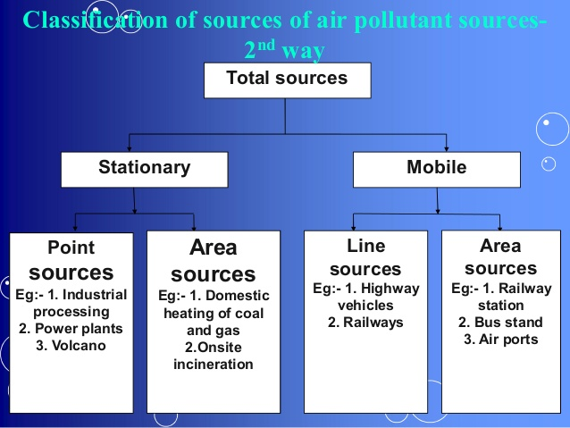
Air Pollution
https://www.slideshare.net/jshrikant/air-poluution-control-l-3

Slide 16
Effects of Air Pollution
EFFECTS ON PLANTS
Damage trees from diseases, pests, drought, frost
EFFECTS ON MATERIALS
Break down the exterior paint
Discolor irreplaceable monuments, statues, beauty sites etc (finance loss)
EFFECTS ON THE STRATOSPHERE
Destruction of the ozone layer (ozone hole)
IMPLICATIONS FOR MANKIND
Effects on human health
Food production
Plant and animal planktons damage
Effect on materials
Effect on climate
Bhopal gas tragedy: Dec 2-3,1984, Union carbide India Limited.
methyl isocyanate gas released and around 10,000 deaths with injuries

